Slide 1
NEBULA: A Neuromorphic Spin-Based Ultra-Low Power Architecture for SNNs and ANNs

Slide 2
Introduction
SNNs have a distinct advantage over their ANN counterparts in that they are capable of operating in an event-driven manner, closely emulating the human brain, thus consuming very low power.
Recent work has demonstrated that SNNs can achieve competitive accuracy at par with standard non-spiking networks (ANNs) for complex image recognition tasks.
When deployed on to low power neuromorphic hardware that is able to leverage their event-driven behavior, SNNs can exhibit an order of magnitude lower power consumption than an iso-network ANN.
In spite of the significant advances, SNN platforms are still quite power-hungry. Many recent approaches have focused on leveraging the emerging technologies such as ReRAM, PCRAM, FeFET.
Notes:
SNN与ANN相比有一个明显的优势，那就是它们能够以“事件驱动”event-driven的方式运行，从而消耗非常低的能耗

Slide 3
Motivation
Most of these technology-driven efforts have focused on small problem sizes, and their scalability to larger applications needs to be established.
There is a lack of efficient HW-SW ecosystem that can support SNNs
Even algorithmic optimizations for improving the accuracy of SNN computations and learning are not fully explored, thereby limiting the efficacy of SNNs
It is essential to consider a holistic approach embracing technology, architecture, and algorithm for designing a neuromorphic ecosystem
Notes:
大多数这些技术驱动的工作都集中在小问题上，需要建立它们对更大应用程序的可扩展性。

Slide 4
Contributions
It uses an ultra-low power MTJ-based synaptic device to design a morphable neuron core that forms the building block for a scalable architecture.
NEBULA can be deployed for an SNN, an ANN as well as a hybrid SNN-ANN network.
We map several deep ANN and SNN workloads to the proposed architecture and perform an in-depth comparative study of accuracy, power and energy efficiency.
Notes:
通过使用神经元层次结构聚合模拟电流的部分和，而不是像以前的工作那样将其转换为数字，从而最大限度地减少ADC的能耗 既可以作为神经突触的crossbar，也可以作为阈值神经元，并且可以在超低电压和电流水平下工作 设计了一个低功耗芯片，该芯片具有部署SNN、ANN以及SNN-ANN混合网络组合的灵活性，这与以前的工作相比具有明显的优势。

Slide 5

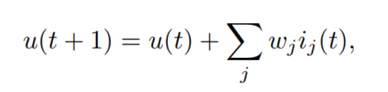
Background
ANN and SNN
Rectified Linear (ReLU) transfer function
Linear-Integrate-Fire (IF) spiking neuron
Inference using IF neurons is based on a rate-encoding framework – the neuron activation value is represented by the total number of spikes emitted by it over a given time window.
Notes:
神经元的膜电压超过阈值V_th后，释放脉冲，然后重置回静息电位V_reset，直到新的输入到达并开始在膜上再次累积。 使用IF神经元的infer是基于rate-coding框架的—神经元的激活值由它在给定时间窗口timestep内发出的脉冲总数表示。

Slide 6
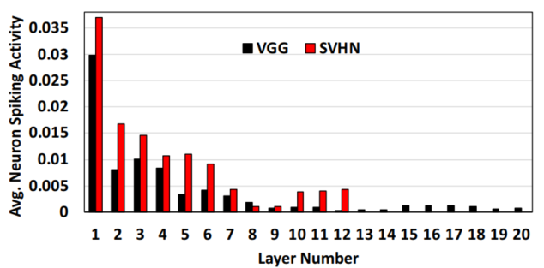
Background
SNN
the spiking activity (average number of spikes fired by a neuron per timestep) gradually decreases as we go deeper into the network
Layerwise average neuron spiking activity
Notes:
网络层数越深，spike activity（神经元每一个时间步长timestep平均激发的脉冲数量）逐渐减少，这意味着事件驱动硬件的能耗降低。

Slide 7
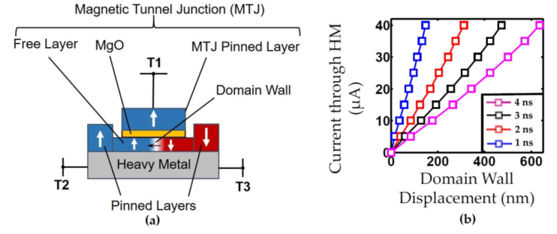
Background
MgO是氧化镁，这里是通过program蓝色和红色部分的比例，来控制整个的阻值。Heavy Metal是重金属层。Domain Wall如果在最右边，就是上（Pinned layer）下都是蓝色，就是低阻态，0。如果Domain Wall处于最左边，下面是红色，就是高阻态，1.
T2和T3给电流
Device Basics: Magnetic Tunnel Junction(MTJ)
In order to map different threshold values, this can be either achieved by choosing an appropriate oxide thickness or scaling the synaptic read voltages
Notes:
MRAM不以电荷或电流存储数据，而是由磁性隧道结MTJ(Magnetic tunneljunction)磁性存储数据。MTJ有三层结构：两个铁磁性板和一个将它们分开的磁通道隔离层/绝缘层其中一个铁磁性板是固定磁化的永磁体（“pinned”层），而另一个铁磁性板的是自由磁化即可以改变磁化 (freelayer）的，即在外部刺激下可以自由改变其方向。
自由层的磁场极化方向是可以改变的,而固定层的磁场方向是固定不变的
MRAM中铁磁性板具有相同的磁化方向时MTJ处于低电阻状态，视为“0”，而相反的磁化方向时MTJ处于高电阻状态，视为“1”。通过测量MTJ的电阻来实现读取数据。

Slide 8
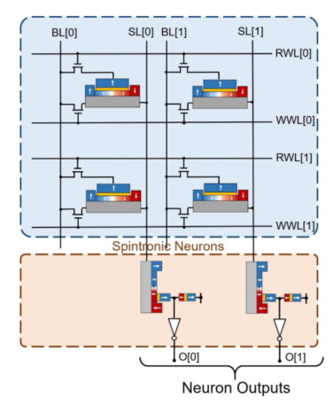
Background
Neuromorphic Crossbar Array
Spintronic neurons are inherently current-driven and thereby, can be easily interfaced with the current outputs provided by the crossbar array unlike voltage-controlled devices, based on RRAM/PCM technologies
DW-MTJ has signiﬁcant potential for power and performance advantages over other competing technologies such as RRAM and PCM.
The accumulated membrane potential at every time step has to be converted via ADC to a digital value. (ISAAC, PRIME, etc)
Notes:
自旋电子神经元本身是电流驱动的，因此，与基于RRAM/PCM技术的电压控制装置不同，可以容易地与crossbar阵列提供的电流输出接口。因此，用MTJ的话，不需要外围的CMOS等
MTJ比PCM、RRAM在能耗、性能方面更有潜力

Slide 9
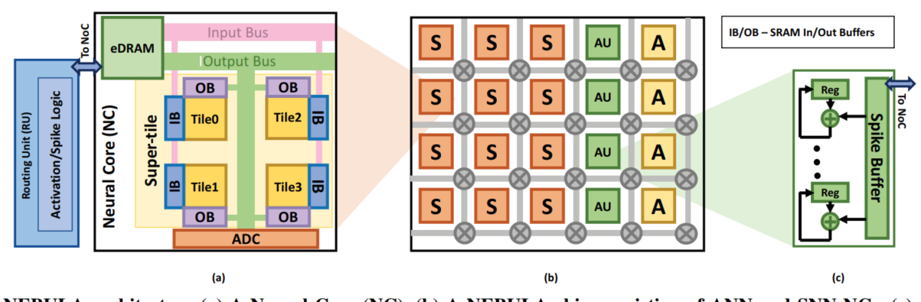
NEBULA Desgin
overview
(a) A Neural Core
(b) A NEBULA chip consisting of ANN and SNN NC
(c) Accumulator
Unit (AU) to support hybrid mode

Slide 10
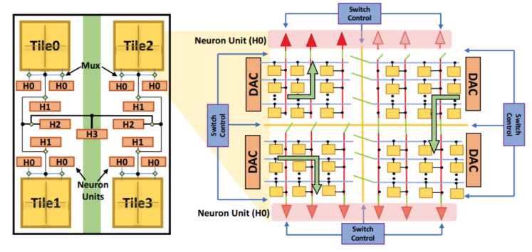
NEBULA Desgin
in tandem with other ACs in a tile when they are connected via a programmable switch.
overview
atomic crossbars (ACs)
Due to rigid array dimensions, sometimes many of the synaptic connections are unused. In contrast, smaller crossbars can help boost synapse utilization but will impose additional peripheral circuitry overhead due to kernel fragmentation across multiple crossbars and merge-summing.
Notes:
神经元单元（NU）通过switch连接在crossbar的两个垂直末端，每个NU由一组神经元组成，这些神经元设计用于spiking or non-spiking modes 输入缓冲器将输入作为模拟电压沿位线（BLs）提供给crossbar，这些电压通过在每个突触上编程的电导值进行加权，产生的电流沿着列源线（SLs）求和，从而有效地并行执行几个点积。沿着SL积累的电流通过专门的自旋神经元，并按其大小成比例移动其表示的幅度/magnitude，从而调节神经元的输出
由于严格的阵列尺寸，有时许多突触连接是未使用的。例如，VGG网[76]的第一层将只使用27× 有64个突触在128个× 128纵横制阵列。相比之下，较小的交叉条有助于提高突触利用率，但由于多个交叉条之间的内核碎片和合并求和，会增加额外的外围电路开销。
当通过可编程开关连接时，与瓷砖中的其他AC串联。

Slide 11
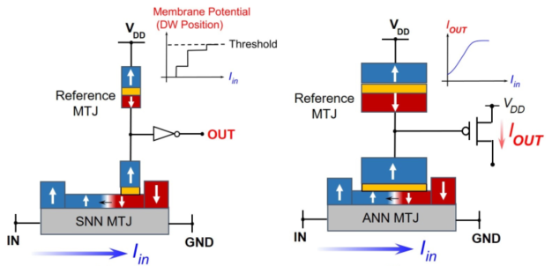
NEBULA Desgin
overview
Notes:
这里的电流改变磁州方向，进而改变电阻。对于ANN来说，I_in 控制了I_out，因为Iin改变了电阻，而电流改变，电阻改变这个连接，相当于三级连接，交点处的电压改变。交点处电压越大，I_out越小。

Slide 12
NEBULA Desgin
in tandem with other ACs in a tile when they are connected via a programmable switch.
atomic crossbars (ACs)
Due to rigid array dimensions, sometimes many of the synaptic connections are unused. In contrast, smaller crossbars can help boost synapse utilization but will impose additional peripheral circuitry overhead due to kernel fragmentation across multiple crossbars and merge-summing.
Notes:
一个层的大的感受野大小通常会溢出XB维度，需要跨多个XB映射。在很多PIM体系结构中，跨越多个xb的点积的部分和首先使用感测放大器（SA）或ADC转换为数字信号，然后使用数字加法器聚合并存储在SRAM寄存器中。如前所述，由于使用ADC进行模数转换，这种操作非常耗电。此外，为了分摊ADC的高功耗和面积成本，它们由多个XB共享，并在列之间进行时间复用。这会影响设计的总体吞吐量。为了减少ADC中聚集部分和的高开销并提高计算吞吐量，我们提出了一种新的由NUs层次结构组成的超级块设计。其关键思想是，我们使用简单的Kirchoff当前定律在当前域中添加部分和，并根据当前映射内核的大小激活适当的NU层次结构级别 . If receptive field size is Rf ≤ M , 我们只激活NU阵列中的第0层，也就是图中的H0，其他的就关了。 If 2M < Rf ≤ 4M ， 我们激活2M x M的crossbar大小，要进一步累计SL上的电流，就激活H1层 因此，如果内核的Rf小于16M，那么它的部分和将在NC中聚合，从而避免了对adc的需要，并通过网络结构发送多个比特。然而，如果Rf>16M，则计算分布在多个NCs上，这些NCs的部分和在RUs处累积，并用加法器和ReLU激活逻辑进行扩充（RU是router unit）

Slide 13
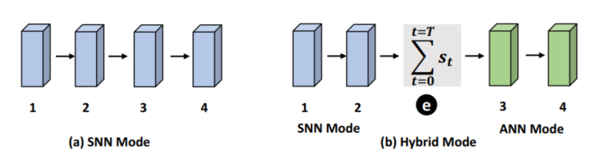
NEBULA Desgin
Longer integration times not only increase inference latency, but also lead to higher energy consumption in SNN hardware.
Hybrid SNN
The output spikes from an intermediate layer are aggregated over time and scaled by a constant factor.

Slide 14
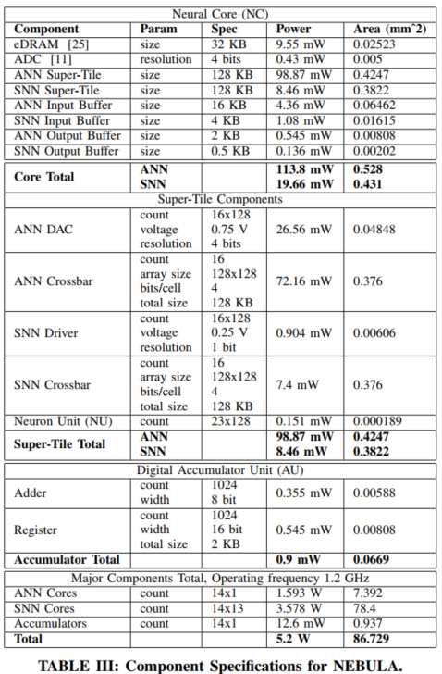
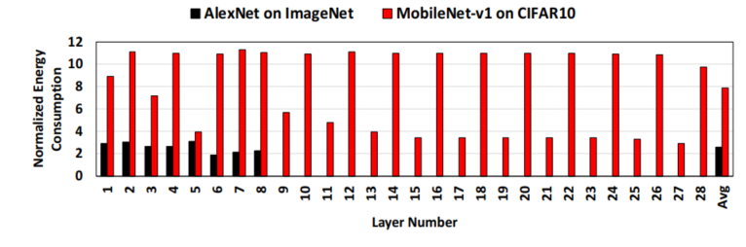
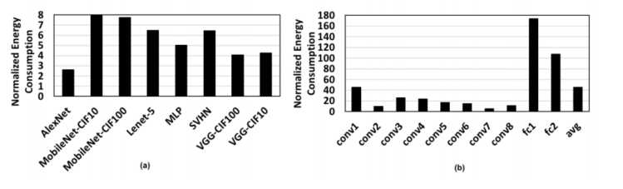
Experiments

Slide 15
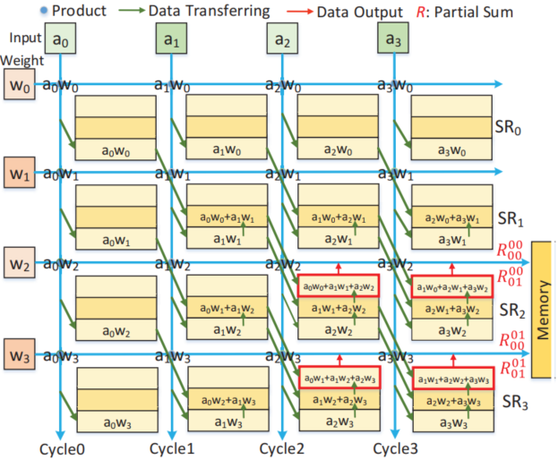
Repetitive Computation Optimization
Product and Partial Sum Reuse (PPSR)
消耗了4个 register来存 储，即SR0-SR3 W0-W2属于第0个 TF，W1-W3属于 第1个TF对应于 j=0,1
每个register (SR)的大 小/行数，和 对应的TF大小 有关，如果TF 需要k次相加 得到psum，那 么就需要k行

Slide 16
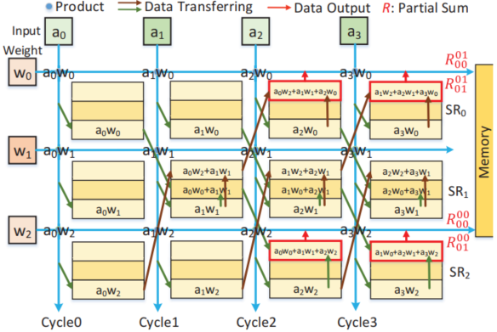
Repetitive Computation Optimization
Product and Partial Sum Reuse (PPSR)

Slide 17
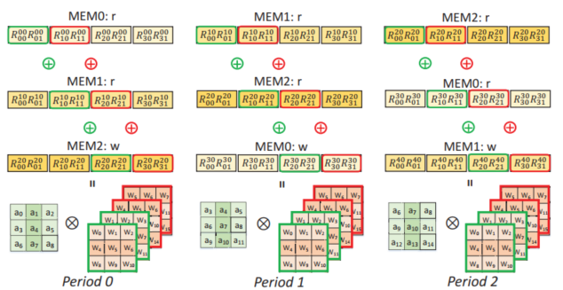
Repetitive Computation Optimization
Entire Row Result Reuse(ERRR)
DCNN: both the memory and PSums of the entire row are cyclically reused, saving hardware resources and eliminating repetitive MACs among different filter rows
Notes:
第 3行row计算 结果需要和前 2行算出的psum 累加得出一个卷积窗口的result

Slide 18
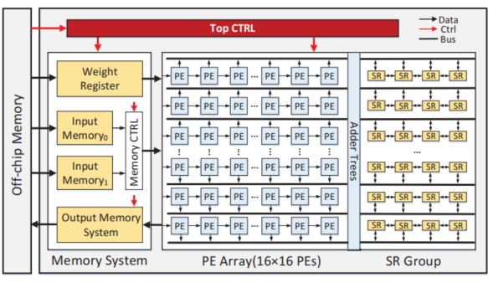
Hardware Architecture
该架构的面积为Eyeriss结构的57.96%，功耗为其24.12%。
传统的架构中， 只有两个global memory，用于 CONV和FC存储 中间数据，即 输入PE阵列的 input data和 PE阵列输出的 output data

Slide 19
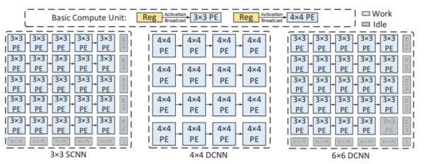
Hardware Architecture
For 11×11 filters in the first layer of AlexNet, they can be first partitioned into nine 4×4 small filters, which can be supported by nine 4×4 PE sub-arrays.

Slide 20
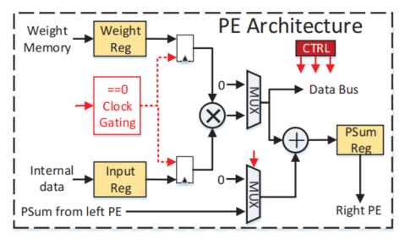
Hardware Architecture
The clock gating technique is used to avoid multipliers’ unnecessary toggling when the weight or input is zero, which can further save approximately 5% of dynamic power.

Slide 21
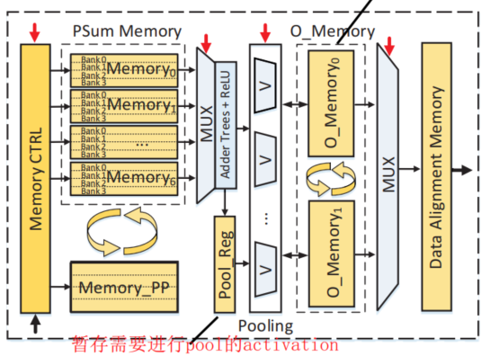
Hardware Architecture
The two pieces of input memory work in ping-pong mode.
O_Memory to support the pooling operation

Slide 22
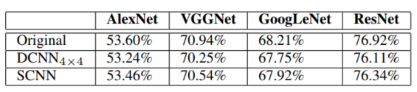
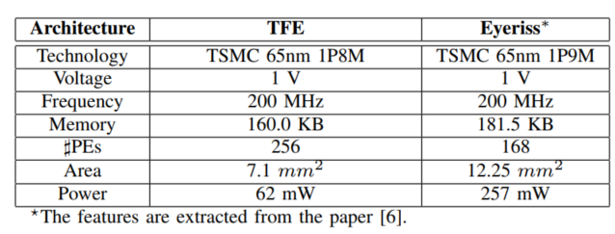
Experimental Results

Slide 23
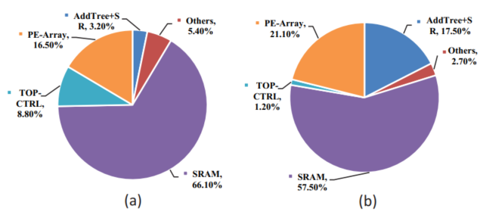
Experimental Results
Area breakdown and power breakdown of the TFE

Slide 24
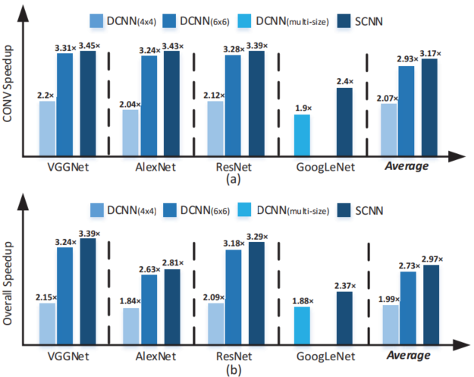
Experimental Results
CONV layers and overall Speedup with the DCNN and SCNN based on the TFE

Slide 25
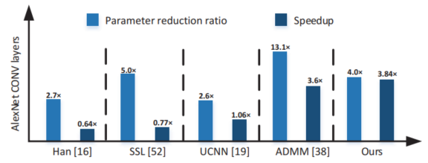
Experimental Results
Parameter reduction ratio and speedup comparison results with compression-based methods on the CONV layers of AlexNet.

Slide 26
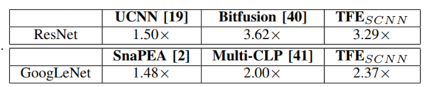
Experimental Results
Parameter reduction ratio and speedup comparison results with compression-based methods on the CONV layers of AlexNet.
Overall speedup of other methods over Eyeriss.

Slide 27
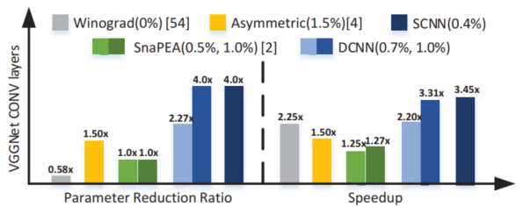
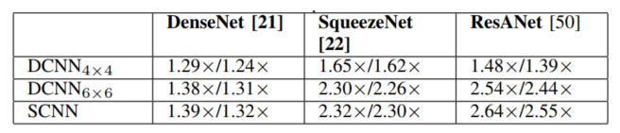
Experimental Results
Parameter reduction ratio and speedup comparison results with computation-reduction-based works on CONV layers of VGGNet
Speedups of CONV layers and overall network with recent networks

Slide 28
谢 谢！

